Slide 1
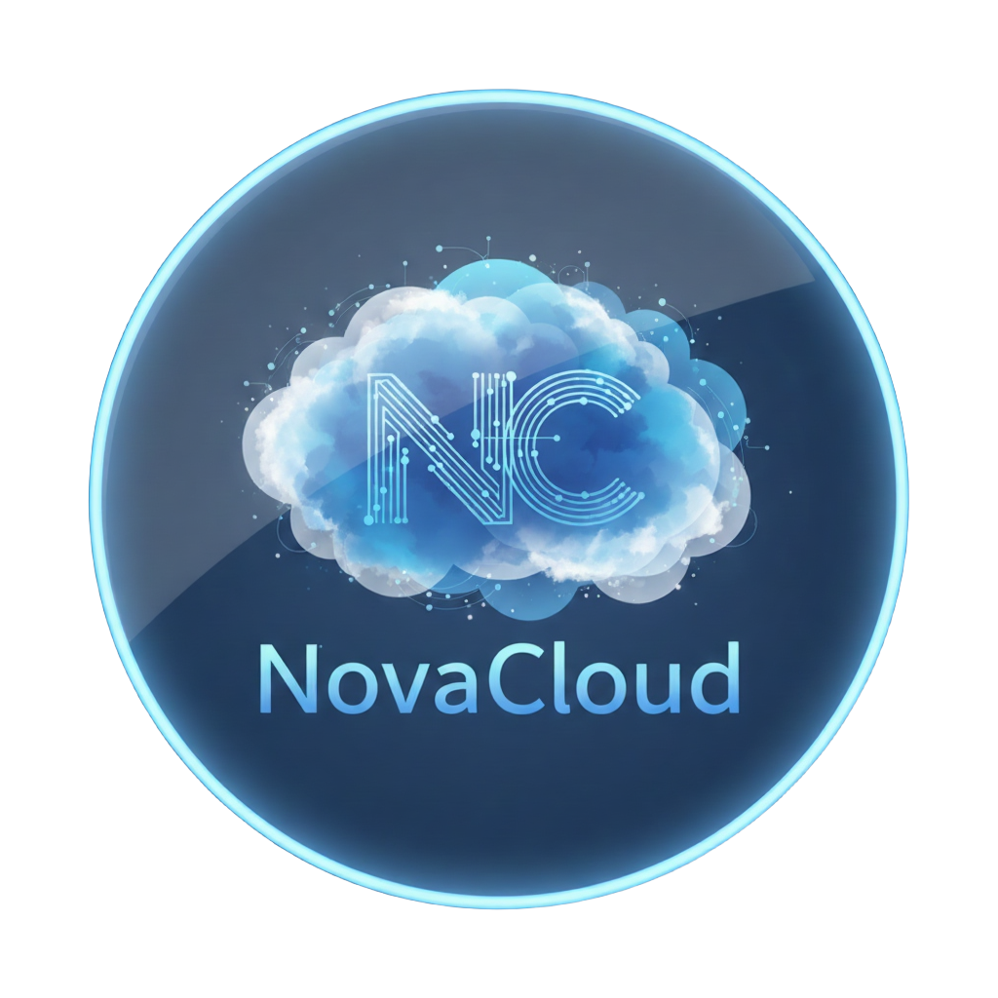
PROJECT PRESENTATION
NovaCloud
Secure. Scalable. Simple.
Presented by: Abraham
Date: December 2025

Slide 2

PART ONE
Introduction & Context
Defining the state of modern cloud infrastructure.

Slide 3


The Explosion of Data
We are creating more data in a single year than in the entire history of humanity combined prior to 2010.
400%
Growth in personal file storage needs since 2020.
The Landscape
6 / 40

Slide 4

Zettabytes.
The world will generate 180 zettabytes of data by 2025.
Are you ready to store it?
Introduction
1 / 40

Slide 5
PART TWO
The Problem
The growing friction of decentralized storage.

Slide 6

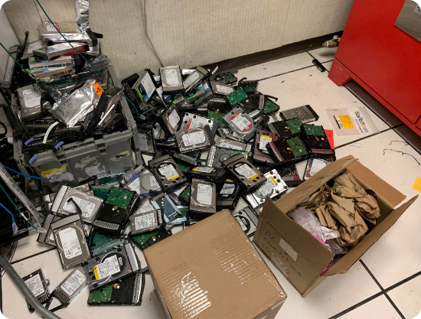
The Old Standard
Physical Hard Drives
For decades, we relied on spinning magnetic disks.
•
Bulky and requires cables.
•
Limited capacity (buy, fill, buy another).
•
Zero accessibility when away from home.
Legacy Tech
7 / 40

Slide 7
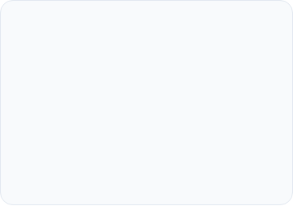
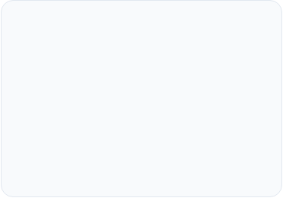
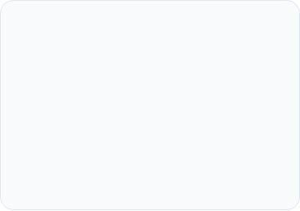



Hardware is Fragile
All hard drives have a 100% failure rate. It's not a matter of if, but when.
Water Damage
Physical Drops
Overheating
One spilled coffee can wipe out a terabyte of work instantly.
Mechanical drives break with a single fall from a desk.
Poor ventilation leads to silent data corruption.
Fragility
9 / 40

Slide 8


Physical Theft
If someone steals your laptop bag, they steal your digital identity.
External drives rarely have encryption enabled by default. Plug it in, and the data is open to anyone.
Statistic
A laptop is stolen every 53 seconds.
Security Risks
10 / 40

Slide 9



The "Old Tech" Struggle
Inaccessible: "I left the file on my home computer."
Fragile: "The drive corrupted. It's all gone."
Limited: "Storage Full. Please delete items."
Isolated: "I can't share this video, it's too big."

Slide 10


PART THREE
The Solution
INTRODUCING
NovaCloud
Secure. Scalable. Yours. The last storage solution you'll ever need.
Reimagining data storage for the modern era.

Slide 11

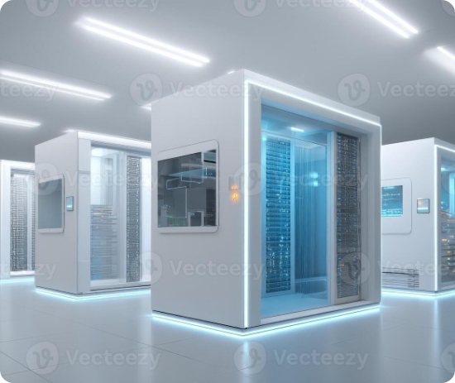
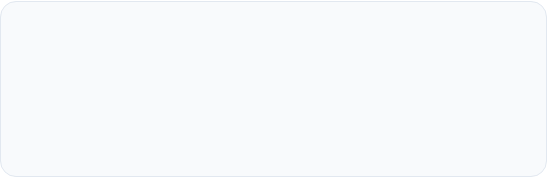
What is "The Cloud"?
It's not magic. It's massive, enterprise-grade data centers.
Instead of storing data on your fragile device, you store it on thousands of secure servers simultaneously.
Decentralization
Your data lives everywhere and nowhere, meaning if one server fails, your data is safe on another.
The Cloud Concept
13 / 40

Slide 12
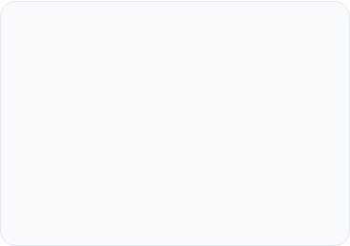
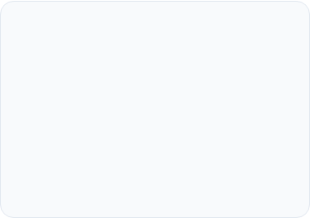



How Cloud Storage Works
1. Upload
2. Storage
Your device encrypts the file and sends it via internet.
The server receives, verifies, and duplicates the file.
Mechanics
14 / 40

Slide 13

PART FOUR
Why NovaCloud?
With giants like Google and TeraBox out there, why choose us?

Slide 14

Security
We use advanced security to keep your data safe. Once uploaded, your file is locked and only you can open it.
End-to-End Encryption
Data Sovereignty (Your data stays safe)
Automated Backups

Slide 15
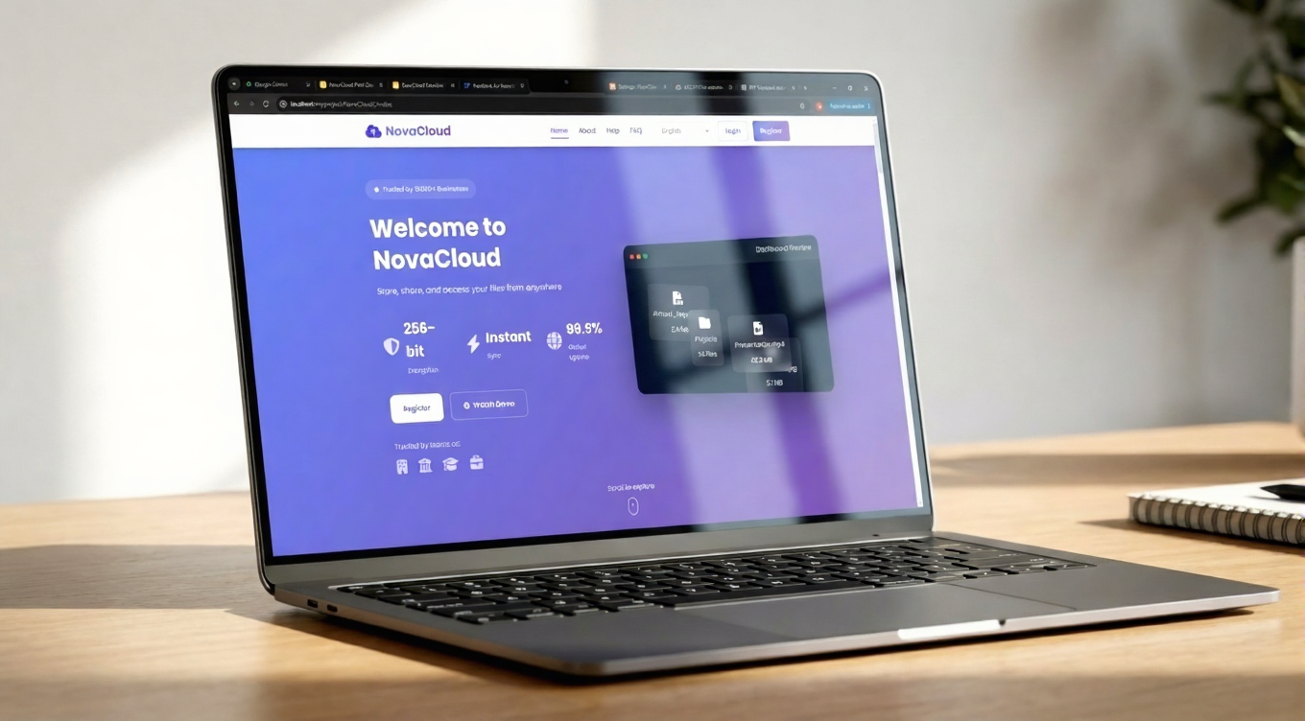
Clean, Intuitive Interface
Designed for clarity. No clutter, just your content.
User Experience
24 / 40

Slide 16
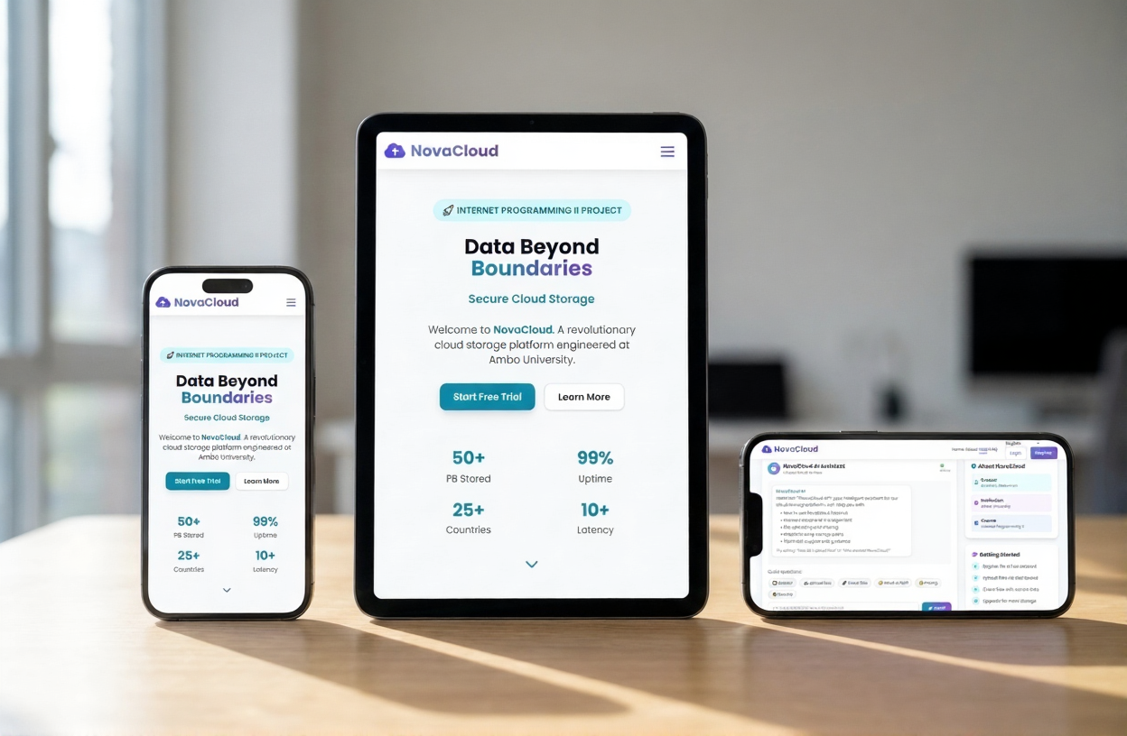
Clean, Intuitive Interface
Designed for clarity. No clutter, just your content.
User Experience
24 / 40

Slide 17




We Speak Your Language
Out of 1.9 billion websites, fewer than 0.01% support Amharic or Afan Oromo. We believe technology should adapt to you, not the other way around.

Slide 18

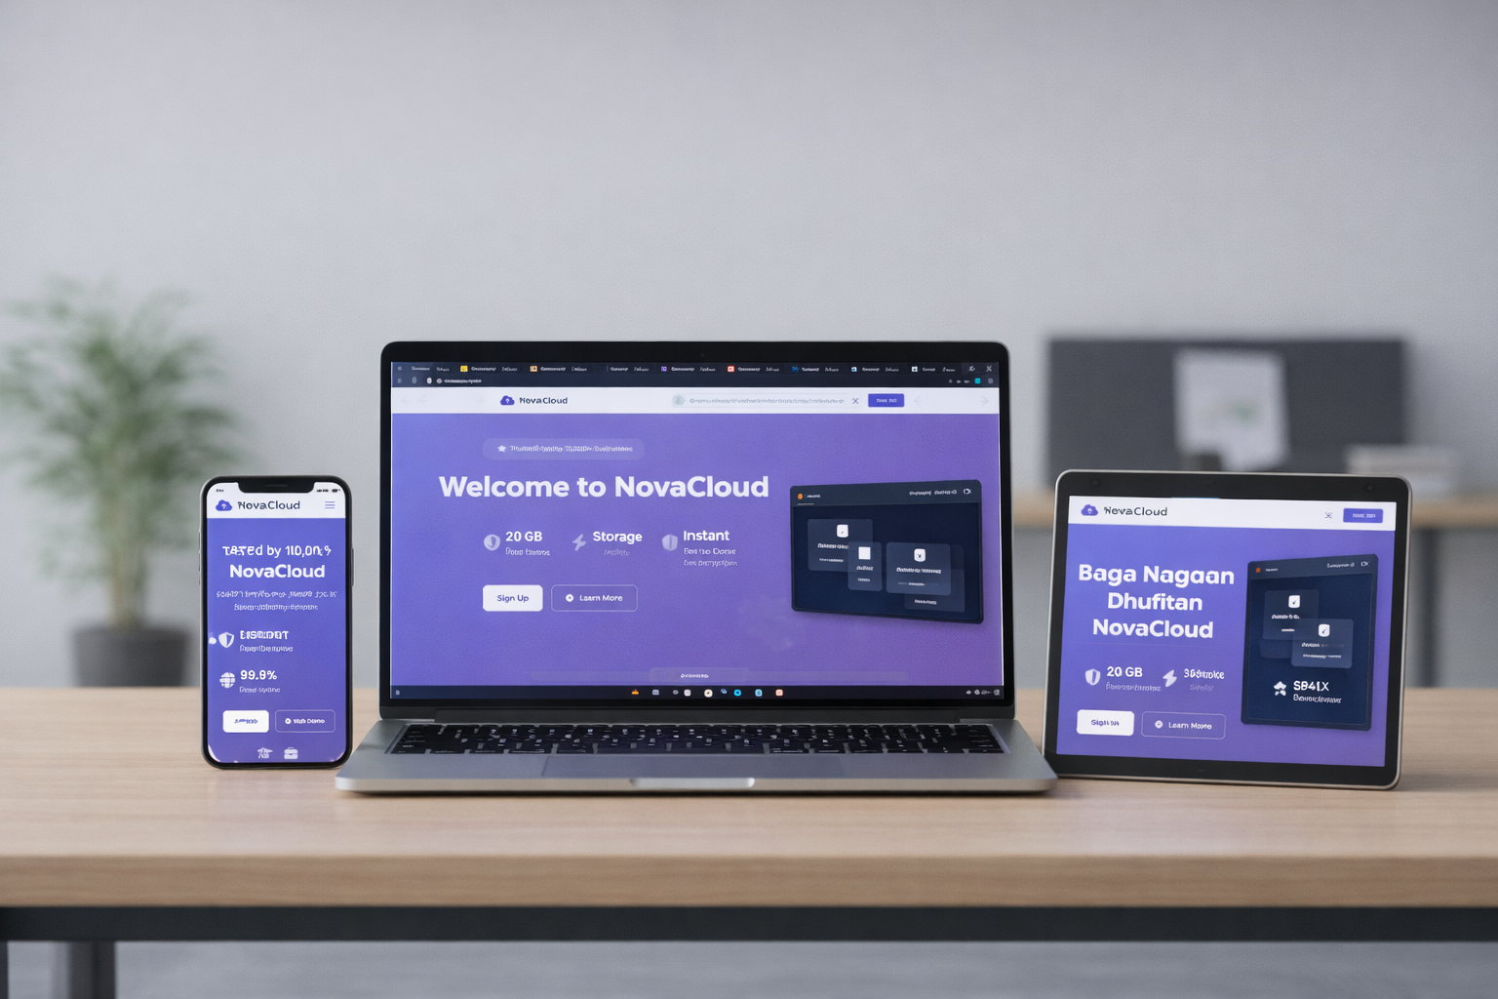
Technology That Speaks Your Language
Clean, Intuitive Interface
No clutter. No confusion. Just your content, beautifully presented.
Inclusive by Design
We proudly offer full support for English, Amharic, and Afan Oromo — because technology should adapt to you.

Slide 19


Why Choose NovaCloud?
Feature | Giants (Google, Dropbox) | NovaCloud
True Privacy | They hold the key. | Zero-Knowledge Encryption.
For Everyone | Global, but generic. | Full Amharic & Oromo support.
AI-Helper | Help you across the website. | Smart Assistant.
Your Control | Their rules. | Data Sovereignty.

Slide 20


Who is NovaCloud for?
Built for Everyone
Students: Store assignments and research securely.
Professionals: Access work files from home or office.
Creatives: Backup high-res photos and videos.

Slide 21
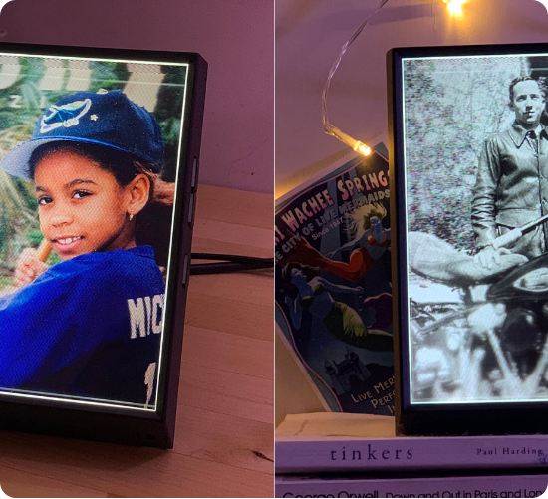
For Photographers & Videographers
Shoot without looking over your shoulder.
Massive File Support: RAW, 4K, 8K—no problem.

Slide 22

For Small Business Owners
Enterprise-grade security, without the IT department.
Admin Dashboard: Control team access easily.
Share Files Easily: Instant sync and share

Slide 23
Key Takeaways
•
Hardware is dead: Physical drives are risky and expensive.
•
Security is paramount: NovaCloud offers zero-knowledge encryption.
•
Accessibility is key: Your data follows you everywhere.
•
AI is the future: A website that have AI helper and assistant is the feature.
Recap
38 / 40

Slide 24

To provide secure, enterprise-grade cloud data protection that prioritizes privacy, simplicity, and global accessibility for modern users and businesses.
— The NovaCloud Mission
Mission
19 / 40

Slide 25

Questions?
We're here to discuss your data future.
Abraham
www.novacloud.com
Presenter
contact@novacloud.com
Q&A
39 / 40

Slide 26


Thank You!
Ready to elevate your data?
Presentation Created By: Abraham
Sources & Data:
TechGlobal Data Loss Report 2024
International Data Security Institute (IDSI)
Cloud Computing Alliance Annual Review
www.novacloud.com

